Slide 1

Home security and door control using rapid face detection method
Aditya Srinivas B - 122003016
Heshwa B - 122003091
Kkrish N A - 122003120
Guide
Dr. A. Suganya
Asst. Professor – II, CSE / SoC

Slide 2
Base Paper
Title: A fast face detection method via convolutional neural network
Year: 2019
Journal - Neurocomputing
Indexing - SCI
Publisher - Elsevier
Base paper URL: https://www.sciencedirect.com/science/article/abs/pii/S0925231219309075

Slide 3
Status of Guide Approval
Yes, we got approved sir!

Slide 4
Abstract
The detection speed is still the biggest bottleneck, which hinders the practical deployment of these face detectors on resource-limited platforms and can’t be used effectively in real-time applications.
Products nowadays require a faster response from the sensors to prevent something worse to happen. To address this issue, a face detection method based on discriminative complete features (DCFs) is to be used and the efficiency of the face detector is significantly improved.
Since many thefts have been happening, the security of homes is becoming vulnerable every day. To secure us from this, a camera can be fitted in the door’s peephole to detect and monitor according to users need.
If any movements of a person are detected in front of the door, it alerts the user and streams the live video, if the user requests.
Simultaneously this face detection model detects the face, captures a snap of their face and sends it to the user’s application. Then the user can take action from remote, whether to allow the person or not.

Slide 5
Literature survey
Title | Work | Method | Year
Face detection using deep learning: An improved faster RCNN approach | A new face detection scheme using deep learning and achieve a good detection performance on the well-known FDDB face detection benchmark evaluation. | Improved by combining many strategies including feature concatenation, hard negative mining, multi-scale training, model pre-training, and proper calibration of key parameters. | 2018
Face Detection with the Faster R-CNN | Applying the Faster RCNN, which has recently demonstrated impressive results on various object detection benchmarks, to face detection. | By training a Faster R-CNN model on the large scale WIDER face dataset, we report best results on the WIDER test set and also in FDDB benchmarks. | 2017
Access Control and Surveillance in a Smart Home | Two IoT based systems in the context of Smart homes: qToggle for multiple home automation, and MotionEyeOS, a video surveillance OS for single-board computers | Most qToggle Devices are based on ESP8266/ESP8285 chips or on Raspberry Pi boards and smart sensors, while MotionEye uses Raspberry Pi boards. | 2021

Slide 6
Existing system
Paper: Face Detection with the Faster R-CNN
Abstract:
This paper applies the Faster RCNN, which has recently demonstrated impressive results on various object detection benchmarks, to face detection.
By training a Faster R-CNN model on the large scale WIDER face dataset, they give a good results on the WIDER test set as well as other widely used face detection benchmarks, FDDB.

Slide 7
Drawback of existing system
Drawbacks:
Fast R-CNN is time-consuming since it extracts features on an image pyramid.
These are not effective at detecting small-sized faces since the object proposal generation methods are designed for generic objects instead of faces.
To overcome:
To eliminate these drawbacks, this paper propose a fast face detection method by direct classification on discriminative complete feature maps.

Slide 8
Proposed System - Base paper
This paper propose a fast face detection method based on discriminative complete features (DCFs) extracted by an elaborately designed convolutional neural network, where face detection is directly performed on the complete feature maps.
DCFs have shown the ability of scale invariance, which is beneficial for face detection with high speed and promising performance.
Therefore like previous papers, extracting multi-scale features on an image pyramid employed in the conventional methods is not required in the proposed method, which can greatly improve its efficiency for face detection.

Slide 9
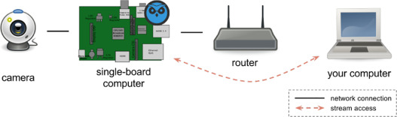
Proposed System
Implement this Face detection model into our home security system.
Whenever a person shows up, this model detects the person’s face sooner.
The detected face is then captured.
The image is then transferred to the user through Raspberry Pi computer via Internet.
The user receives a notification in mobile app.
He/she can control the door’s function to whether allow the person or not.

Slide 10

Methodology

Slide 11

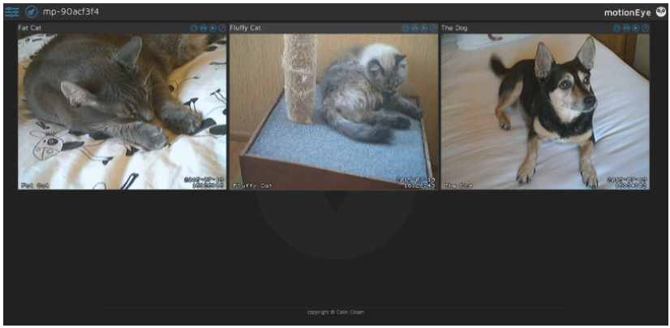

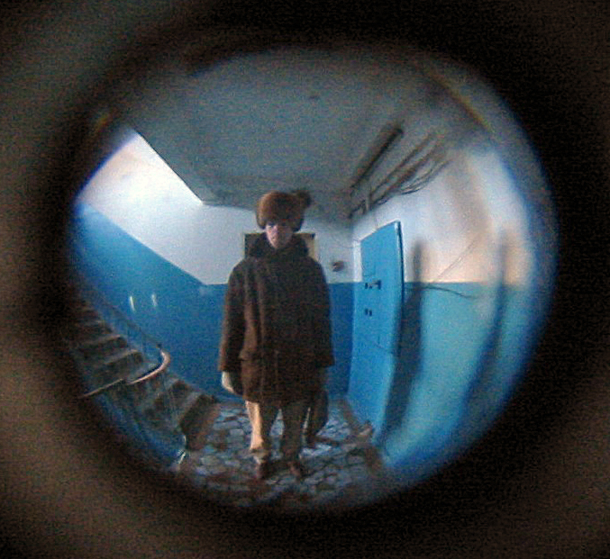

App
Control the door
Live stream / see past detections.
SOS feature
Analyze who are all coming in a timeframe
Face recognition for detected faces (If time permits)
Door 1
Door 2
Door 3

Slide 12
References
H. Jiang, E.G. Learned-Miller, Face detection with the faster R-CNN, CoRRabs/1606.03473 (2016)
R. Girshick, Fast R-CNN, in: Proceedings of the IEEE Conference Computer Vision and Pattern Recognition, 2015, pp. 1440–1448
Cristina Stolojescu-Crisan, Access Control and Surveillance in a Smart Home, (2021), High-Confidence Computing, pp. 100036
Waheb A. Jabbar, Design and Fabrication of Smart Home With Internet of Things Enabled Automation System, in: IEEE Access (Vol: 7), (2019), pp. 144059 – 144074

